Slide 1
Chapter 4: Measures of Variability

Slide 2
Introduction
Need for measures of variability:
Used to describe data.
Measures of variability:
The Index of Qualitative Variation.
Range.
Interquartile range.
Standard deviation.
Variance.
Notes:
Satisfies Learning Objective 4.1: Explain the importance of measuring variability.
Need for measures of variability: Measures of central tendency when used alone may mislead rather than inform.
Summarizing a distribution of data: Summarizing a distribution of data is by selecting a single number that describes how much variation and diversity there is in the distribution.
Used to describe data: Often, measures of central tendency are used along with measures of variability to describe data.

Slide 3
The Importance of Measuring Variability
Examine variation and diversity.
Stereotyping: Ignoring diversity.
Understanding diversity of experiences.
Reconstructing curriculum: Responsive to the student.
Notes:
Satisfies Learning Objective 4.1: Explain the importance of measuring variability.
Examine differences as well as commonalities: To address the similarities without dealing with differences, it is important to look at the differences as well as the commonalities.
Stereotyping: Ignoring diversity: One form of stereotyping is treating a group as if it were totally characterized by its central value, ignoring the diversity within the group.
Understanding diversity of experiences: The different measures of variation can be used to understand the diversity of experiences. The concept of variability has implications not only for describing the diversity of social groups but also for issues that are important in everyday life.
Reconstructing curriculum: Responsive to the student: One of the most important issues facing the academic community is how to reconstruct the curriculum to make it more responsive to the needs of students. This type of information, including that on the scores, and about the central tendency in a distribution is obtained by measures of variability.

Slide 4
The Index of Qualitative Variation (1 of 3)
A measure of variability for nominal variables.
Need for Index of Qualitative Variation (IQV).
Range of IQV: 0.00 to 1.00.
Notes:
Satisfies Learning Objective 4.2: Calculate and interpret the index of qualitative variation, range, interquartile range, the variance, and the standard deviation.
A measure of variability for nominal variables: The Index of Qualitative Variation (IQV) is a measure of variability for nominal variables. It is based on the ratio of the total number of differences in the distribution to the maximum number of possible differences within the same distribution.
Need for Index of Qualitative Variation: Due to demographic changes, rethink every conceptualization of society. For example, to compare racial/ethnic diversity in different cities, regions, or states or find out if a group has become more racially and ethnically diverse over time, the IQV is used.
Range of IQV: 0.00–1.00: Index can vary from 0.00 to 1.00. When all cases in one category, no variation (or diversity), IQV is 0.00. When cases distributed evenly across categories, maximum variation (or diversity), IQV is 1.00.

Slide 5
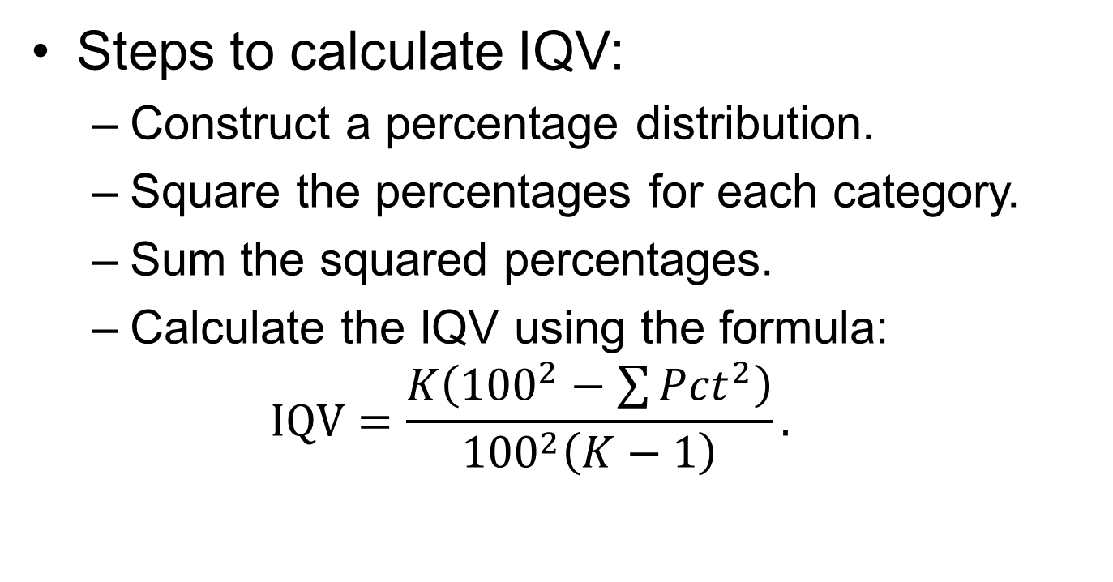
The Index of Qualitative Variation (2 of 3)
Steps to calculate IQV:
Construct a percentage distribution.
Square the percentages for each category.
Sum the squared percentages.
Calculate the IQV using the formula:
$$IQV=\frac{K\left({100}^{2}−\sum{P{ct}^{2}}\right)}{{100}^{2}\left(K−1\right)}.$$
Notes:
Satisfies Learning Objective 4.2: Calculate and interpret the index of qualitative variation, range, interquartile range, the variance, and the standard deviation.
Steps to calculate IQV:
Construct a percentage distribution.
Square the percentages for each category.
Sum the squared percentages.
Calculate the IQV using the formula:
$$IQV=\frac{K\left({100}^{2}−\sum{P{ct}^{2}}\right)}{{100}^{2}\left(K−1\right)}$$
where K is the number of categories, and$\sum{P{ct}^{2}}$is the sum of all squared percentages in the distribution.

Slide 6
The Index of Qualitative Variation (3 of 3)
Expressing the IQV as a Percentage
Multiplying the IQV by 100.
Relative to the maximum possible differences.
Notes:
Satisfies Learning Objective 4.2: Calculate and interpret the index of qualitative variation, range, interquartile range, the variance, and the standard deviation.
Multiplying the IQV by 100: The IQV can also be expressed as a percentage rather than a proportion, by simply multiplying the IQV by 100.
Relative to the maximum possible differences: IQV reflects percentage of racial/ethnic differences relative to the maximum possible differences in each distribution. Thus, an IQV of 0.07 indicates that the number of racial/ethnic differences is 12.0% (0.12 x 100) of the maximum possible differences.

Slide 7
Statistics in Practice: Diversity in US Society
United States soon to be minority–majority nation.
Geographic concentrations of groups.
Chain migration.
IQV can measure diversity in regions.
Notes:
By the middle of the 21st century, the United States will no longer be a predominantly white society—it will be a minority–majority nation.
There are geographic concentrations of minority groups in specific regions and metropolitan areas; demographers refer to this as chain migration.
IQV can be used to measure the amount of racial and ethnic diversity in different regions.

Slide 8
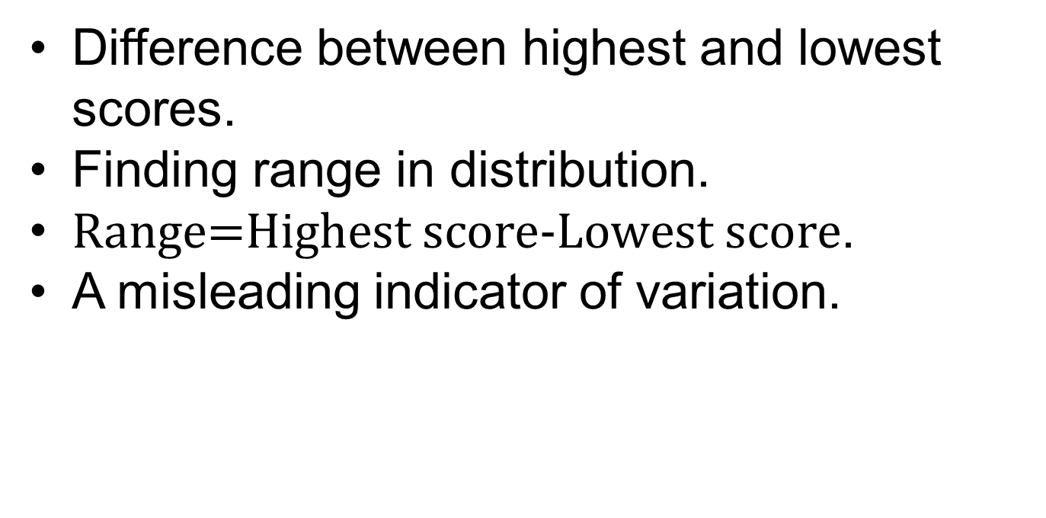
The Range
Difference between highest and lowest scores.
Finding range in distribution.
$\text{Range} \text{=} \text{Highest} \text{score} \text{−} \text{Lowest} \text{score}$.
A misleading indicator of variation.
Notes:
Satisfies Learning Objective 4.2: Calculate and interpret the index of qualitative variation, range, interquartile range, the variance, and the standard deviation.
Difference between highest and lowest scores: Range measures variation in interval-ratio variables. It is the difference between the highest (maximum) and the lowest (minimum) scores in the distribution.
Finding range in distribution: To find ranges in distribution, one must pick out highest and lowest scores in distribution and subtract them.
Formula: $Range=Highest score−Lowest score$
A misleading indicator of variation: Range is simple and quick to calculate crude measure because it is based on only the lowest and the highest scores. These two scores might be extreme and rather atypical, makes the range misleading indicator of variation in distribution.

Slide 9
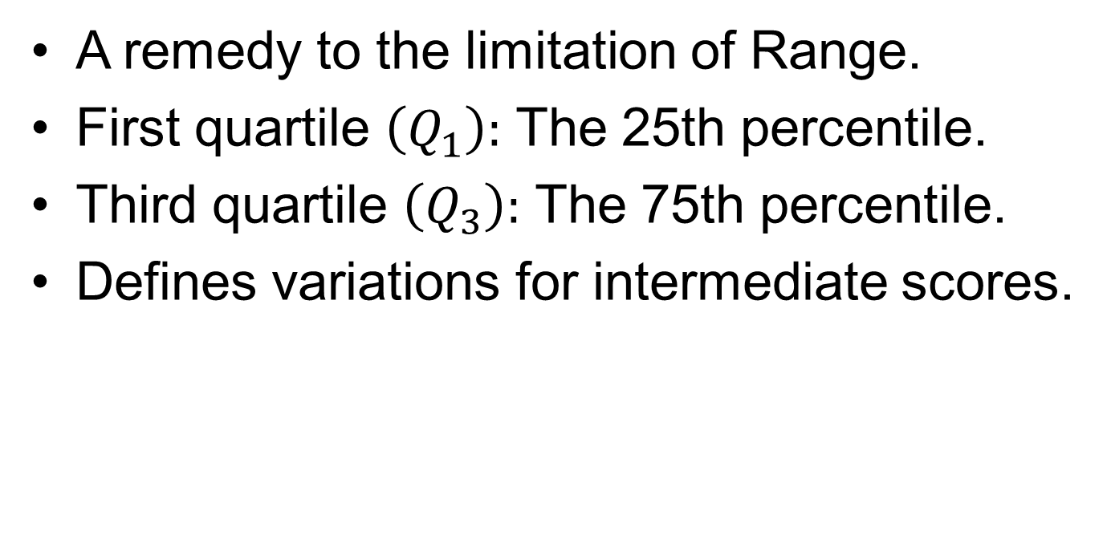
The Interquartile Range (1 of 2)
A remedy to the limitation of range.
First quartile $\left(Q_{1}\right):$ The 25th percentile.
Third quartile $\left(Q_{3}\right):$ The 75th percentile.
Defines variations for intermediate scores.
Notes:
Satisfies Learning Objective 4.2: Calculate and interpret the index of qualitative variation, range, interquartile range, the variance, and the standard deviation.
A remedy to the limitation of range: The interquartile range (IQR), a measure of variation for interval-ratio and ordinal variables, is the width of the middle 50% of the distribution. It is defined as the difference between the lower and upper quartiles $\left(Q_{1} and Q_{3}\right)$.
First quartile $\left(Q_{1}\right):$ The 25th percentile: The first quartile is the point at which 25% of the cases fall below it and 75% above it.
Third quartile $\left(Q_{3}\right)$ is 75th percentile: The third quartile is the point at which 75% of the cases fall below it and 25% above it.
Defines variations for intermediate scores: The IQR, therefore, defines variation for the middle 50% of the cases. Like the range, the IQR is based on only two scores. However, because it is based on intermediate scores, rather than on the extreme scores in the distribution, it avoids some of the instability associated with the range.

Slide 10
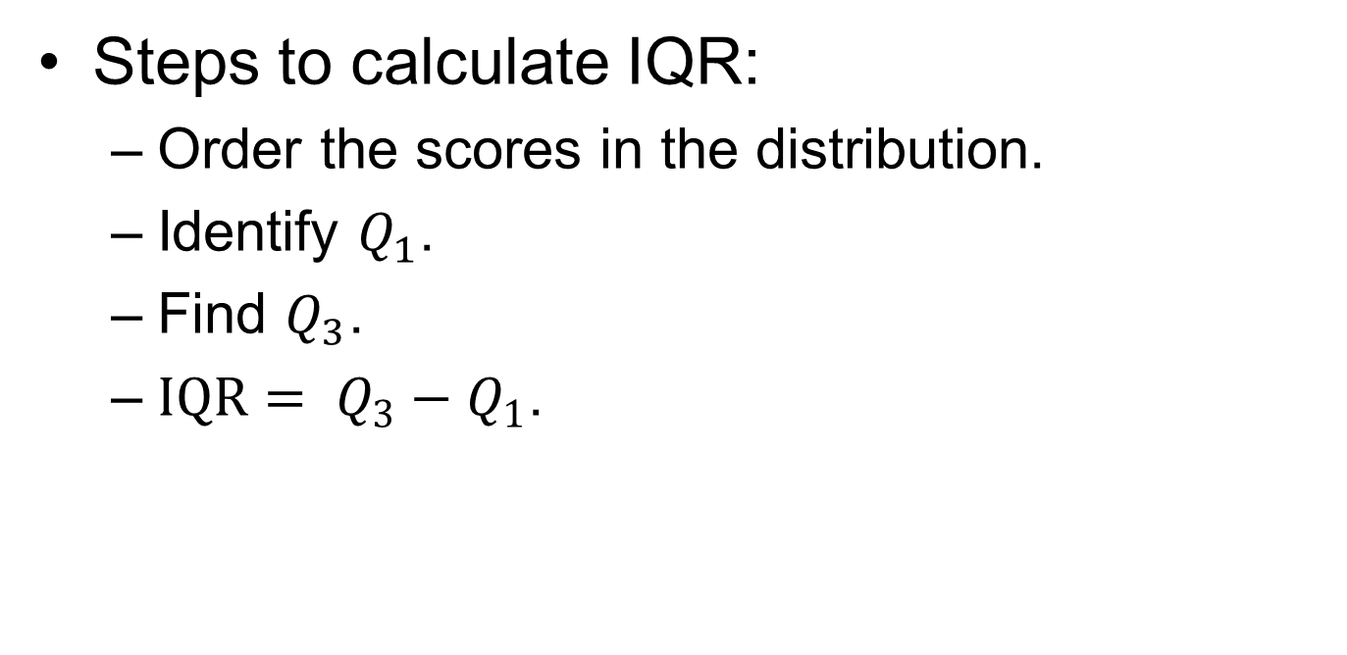
The Interquartile Range (2 of 2)
Steps to calculate IQR:
Order the scores in the distribution.
Identify $Q_{1}$.
Find $Q_{3}$.
$IQR= Q_{3}−Q_{1}$.
Notes:
Satisfies Learning Objective 4.2: Calculate and interpret the index of qualitative variation, range, interquartile range, the variance, and the standard deviation.
Steps to calculate IQR:
Order the scores in the distribution: To find $Q_{1}$ and $Q_{3}$, order the scores in the distribution from the highest to the lowest score, or vice versa.
Identify $Q_{1}:Q_{1} \text{is} \text{the} \text{first} \text{quartile} \text{or} \text{the}\text{ 25}\text{th} \text{percentile}$. To find $Q_{1}$, we multiply N by 0.25.
Find $Q_{3}:Q_{3} \text{is} \text{the} \text{third} \text{quartile} \text{or} \text{the}\text{ 75}\text{th} \text{percentile}$. To find $Q_{3}$, we multiply N by 0.75.
$IQR= Q_{3}−Q_{1}:$ We calculate the IQR by finding the difference between $Q_{3}$ and $Q_{1}$, using the formula $IQR= Q_{3}−Q_{1}$. It may be more useful to report the full IQR ($Q_{3} \text{to} Q_{1}$) rather than the single value (the difference).

Slide 11
The Box Plot
A graphic device.
Drawing a box plot.
Visual impressions from a box plot.
Symmetry of the box plot.
Notes:
Satisfies Learning Objective 4.2: Calculate and interpret the index of qualitative variation, range, interquartile range, the variance, and the standard deviation.
A graphic device: A box plot is a graphic device that is used to visually present range, IQR, median, lowest (minimum) score, and highest (maximum) score. It provides a way to visually examine center, variation, and shape of distributions of interval-ratio variables.
Drawing a box plot: We can easily draw a box plot by hand following these instructions:
Draw a box between lower and upper quartiles.
Draw a solid line within the box to mark the median.
Draw vertical lines (called whiskers) outside the box, extending to the lowest and highest values.
Visual impressions from a box plot: From creating a box plot, obtain visual impression of:
The center of the distribution, which is easily identified by the solid line inside the box.
Box drawn between lower and upper quartiles, where IQR is reflected in the height of the box.
Length of vertical lines outside the box (on both ends), where the range of the distribution.
The relative position of the box and the position of the median within the box, which tell us whether the distribution is symmetrical or skewed.
Symmetry of the box plot: Perfectly symmetrical distribution occurs when the box at center of range, median in center of box. When distribution departs from symmetry, box and/or median not centered; closer to lower quartile when more cases with lower scores or to upper quartile when more cases with higher scores.

Slide 12
The Variance and the Standard Deviation (1 of 7)
Overall variations in distributions.
Mean: A reference point.
Variance: Average of squared deviations.
Standard deviation: Square root of variance.
Notes:
Satisfies Learning Objective 4.2: Calculate and interpret the index of qualitative variation, range, interquartile range, the variance, and the standard deviation.
Overall variations in distributions: The mean reflects how much, on the average, each score in the distribution deviates from some central point.
Mean: A reference point: The mean is used as the reference point rather than other kinds of averages (the mode or the median) because the mean is based on all the scores in the distribution. The sensitivity of the mean to extreme values carries over the calculation of the average deviation, which is based on the mean. More advanced measures of variation require the use of algebraic properties that can be assumed only by using the arithmetic mean.
Variance: Average of squared deviations: The variance is the average of the squared deviations from the center (mean) of the distribution.
Standard deviation: Square root of variance: Standard deviation is the square root of the variance. Both variance and standard deviation measure variability in interval-ratio and ordinal variables.

Slide 13
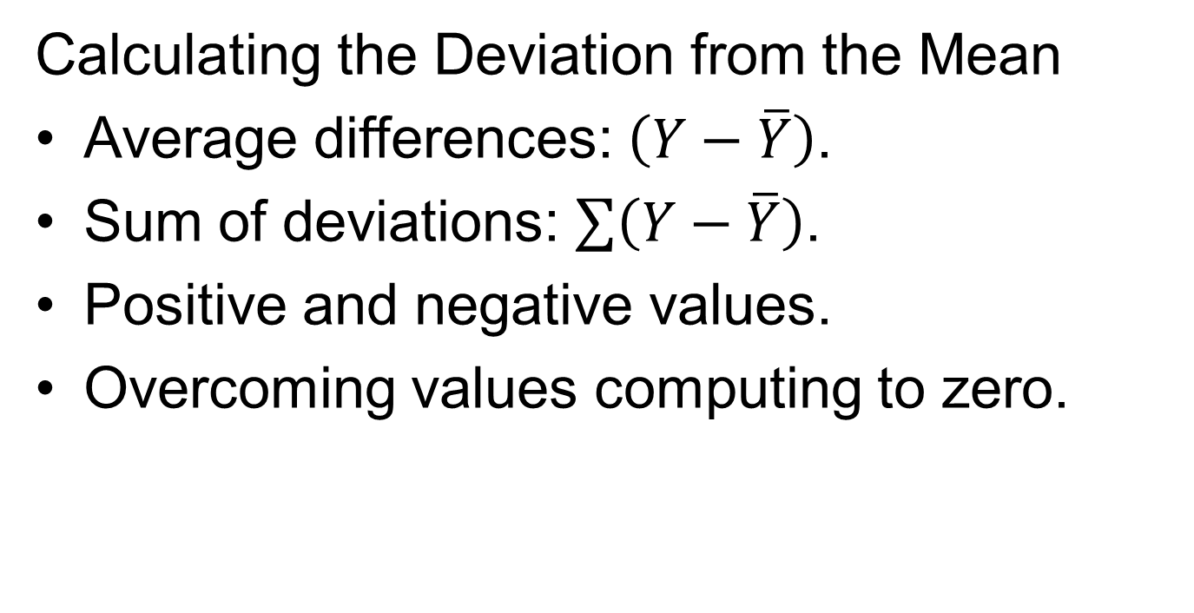
The Variance and the Standard Deviation (2 of 7)
Calculating the Deviation from the Mean
Average differences: $\left(Y−\overline{Y}\right)$.
Sum of deviations: $\sum{\left(Y−\overline{Y}\right)}$.
Positive and negative values.
Overcoming values computing to zero.
Notes:
Satisfies Learning Objective 4.2: Calculate and interpret the index of qualitative variation, range, interquartile range, the variance, and the standard deviation.
Average differences: $\left(Y−\overline{Y}\right)$: While calculating the difference between the average difference of the selected values, from the total average (the mean), it makes sense to first look at the difference between each value and the mean. This difference, called a deviation from the mean, is symbolized as $\left(Y−\overline{Y}\right)$.
Sum of deviations: $\sum{\left(Y−\overline{Y}\right)}:\text{The} \text{sum} \text{of} \text{the} \text{deviations} \text{between} \text{the} \text{average} \text{difference} \text{of} \text{the} \text{selected} \text{values} \text{can} \text{be} \text{symbolized} \text{as} \sum{\left(Y−\overline{Y}\right)}\text{.}$
Positive and negative values: The deviation is positive when the percentage change in the selected value is above the mean. It is negative when the percentage change is below the mean.
Overcoming values computing to zero: If we subtract mean from each score, add up deviations, sum would be zero, cause average deviation to compute to zero. Mean is center of gravity of distribution. Mathematically, one can overcome this problem by using absolute values of deviations, or by squaring deviations, that is multiplying each deviation by itself to get rid of negative sign. Absolute values difficult to work with mathematically, latter method compensates for problem.
Table 4.8: Same information as Table 4.7, squared actual deviations from mean and added together squares. Sum of squared deviations is symbolized as $\sum{{\left(Y−\overline{Y}\right)}^{2}}$. By squaring deviations, a sum representing the deviation from mean, positive. (This sum zero if all cases have same value as mean.) For example, $\sum{{\left(Y−\overline{Y}\right)}^{2}=12.23}.$

Slide 14
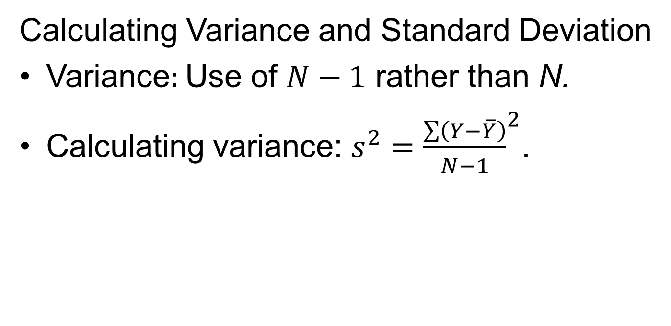
The Variance and the Standard Deviation (3 of 7)
Calculating Variance and Standard Deviation
Variance: Use of $N−1$ rather than N.
Calculating variance: $s^{2}={\frac{\sum{\left(Y−\overline{Y}\right)}}{N−1}}^{2}$.
Notes:
Satisfies Learning Objective 4.2: Calculate and interpret the index of qualitative variation, range, interquartile range, the variance, and the standard deviation.
Variance: Use of $N−1$ rather than N: In calculating variance, we are interested in the average of the squared deviations from the mean. Therefore, we need to divide the sum of the squared deviations by the number of scores (N) in the distribution. However, unlike the calculation of the mean, we will use $N−1$ rather than N in the denominator.
Calculating variance:
$$s^{2}={\frac{\sum{\left(Y−\overline{Y}\right)}}{N−1}}^{2}$$
where $s^{2}$ is the variance, $\left(Y−\overline{Y}\right)$ is the deviation from the mean, $\sum{{\left(Y−\overline{Y}\right)}^{2}}$ is the sum of the squared deviations from the mean, and N is the number of scores.

Slide 15
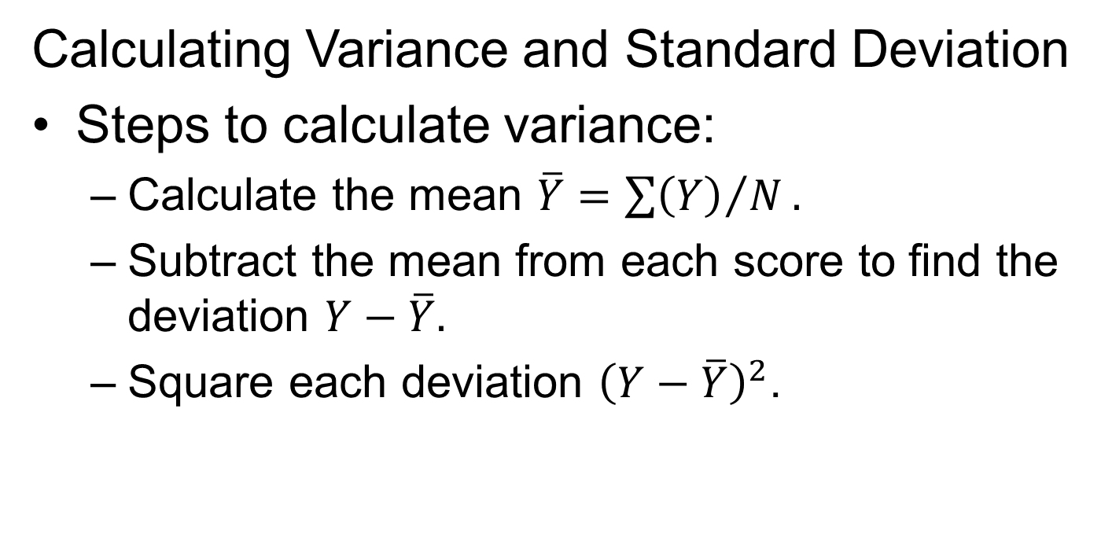
The Variance and the Standard Deviation (4 of 7)
Calculating Variance and Standard Deviation
Steps to calculate variance:
Calculate the mean $\overline{Y}={\sum{\left(Y\right)}}/N.$
Subtract the mean from each score to find the deviation $Y−\overline{Y}.$
Square each deviation ${\left(Y−\overline{Y}\right)}^{2}$.
Notes:
Satisfies Learning Objective 4.2: Calculate and interpret the index of qualitative variation, range, interquartile range, the variance, and the standard deviation.
Steps to calculate variance: To calculate variance, follow the step-by-step procedure:
Calculate the mean $\overline{Y}={\sum{\left(Y\right)}}/N.$
Subtract the mean from each score to find the deviation $Y−\overline{Y}.$
Square each deviation ${\left(Y−\overline{Y}\right)}^{2}$.

Slide 16
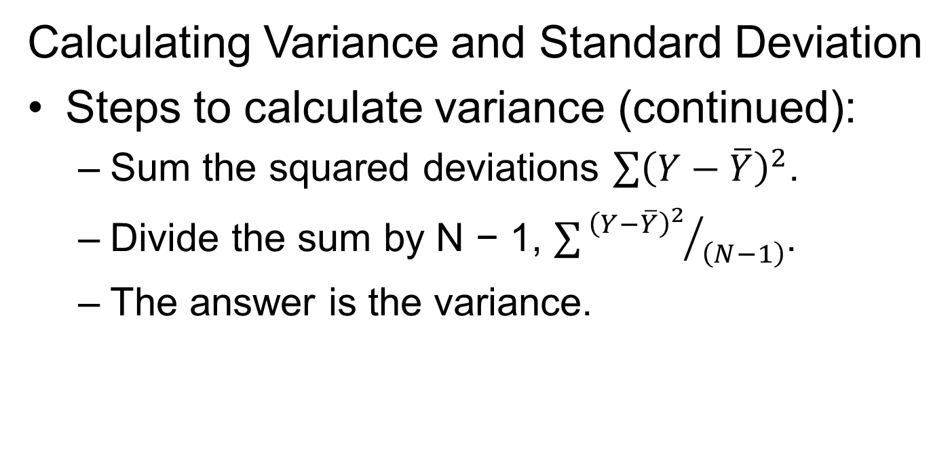
The Variance and the Standard Deviation (5 of 7)
Calculating Variance and Standard Deviation
Steps to calculate variance (continued):
Sum the squared deviations $\sum{{\left(Y−\overline{Y}\right)}^{2}}$.
Divide the sum by N − 1, $\sum{{{\left(Y−\overline{Y}\right)}^{2}}/{\left(N−1\right)}}$.
The answer is the variance.
Notes:
Satisfies Learning Objective 4.2: Calculate and interpret the index of qualitative variation, range, interquartile range, the variance, and the standard deviation.
Steps to calculate variance (continued):
Sum the squared deviations $\sum{{\left(Y−\overline{Y}\right)}^{2}}$.
Divide the sum by N − 1, $\sum{{{\left(Y−\overline{Y}\right)}^{2}}/{\left(N−1\right)}}$.
The answer is the variance.

Slide 17
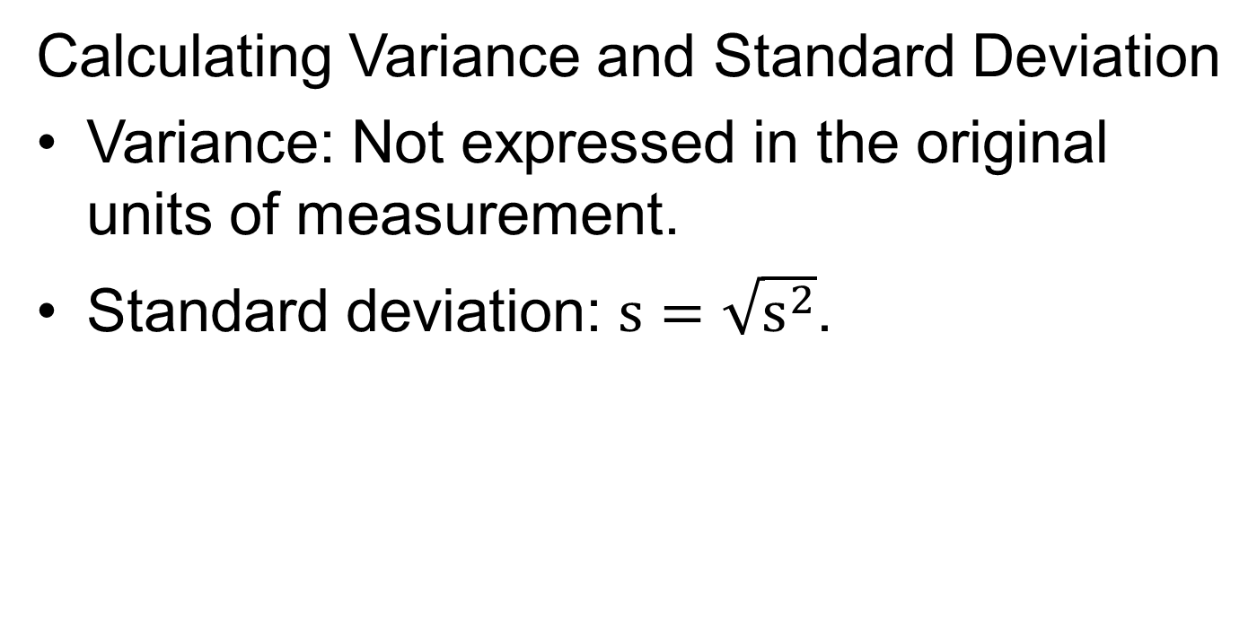
The Variance and the Standard Deviation (6 of 7)
Calculating Variance and Standard Deviation
Variance: Not expressed in the original units of measurement.
Standard deviation: $s=\sqrt{s^{2}}$.
Notes:
Satisfies Learning Objective 4.2: Calculate and interpret the index of qualitative variation, range, interquartile range, the variance, and the standard deviation.
Variance: Not expressed in the original units of measurement: A major problem with the variance is that it is based on squared deviations and therefore is no longer expressed in the original units of measurement.
Standard deviation: $s=\sqrt{s^{2}}$: In order to solve the problem of variance, we take the square root of the variance and interpret it. This gives us the standard deviation, symbolized as s, which is the square root of the variance, or $s=\sqrt{s^{2}}$.

Slide 18
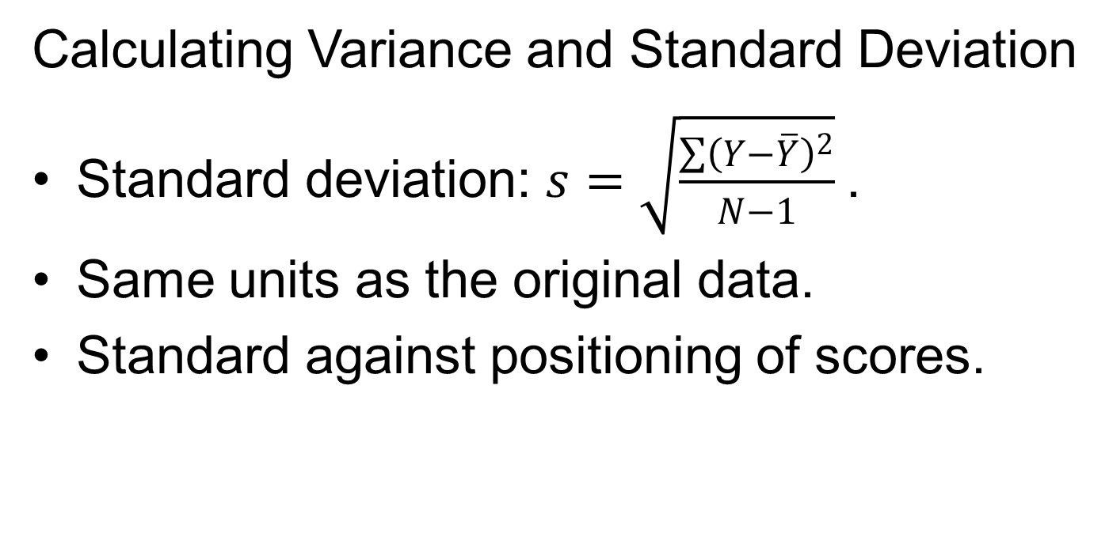
The Variance and the Standard Deviation (7 of 7)
Calculating Variance and Standard Deviation
Standard deviation: $s=\sqrt{\frac{\sum{{\left(Y−\overline{Y}\right)}^{2}}}{N−1}}$.
Same units as the original data.
Standard against positioning of scores.
Notes:
Satisfies Learning Objective 4.2: Calculate and interpret the index of qualitative variation, range, interquartile range, the variance, and the standard deviation.
Standard deviation:$s=\sqrt{\frac{\sum{{\left(Y−\overline{Y}\right)}^{2}}}{N−1}}$: The standard deviation is equal to the square root of the average of the squared deviations from the mean. Thus, the formula used is $s=\sqrt{\frac{\sum{{\left(Y−\overline{Y}\right)}^{2}}}{N−1}}$.
Same units as the original data: The advantage of the standard deviation is that unlike the variance, it is measured in the same units as the original data. If the original data are expressed in percentages, this number is expressed as a percentage as well. In a distribution where all the scores are identical, the standard deviation is zero.
Standard against positioning of scores: The standard deviation can be considered a standard against which we can evaluate the positioning of scores relative to the mean and to other scores in the distribution. In most distributions, unless they are highly skewed, the majority of scores would fall within 1 standard deviation of the mean.

Slide 19
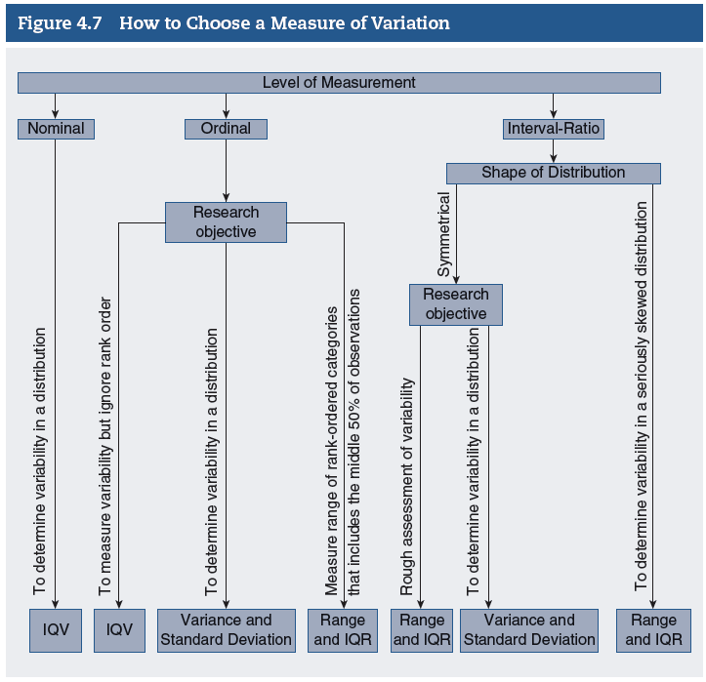
Considerations for Choosing Measures of Variation (1 of 2)
Notes:
Satisfies Learning Objective 4.3: Identify the relative strengths and weaknesses of the measures.
Figure 4.8: Decision tree.

Slide 20
Considerations for Choosing Measures of Variation (2 of 2)
Choosing a measure of central tendency: Variable’s level of measurement.
Requires appropriate data measure.
Notes:
Satisfies Learning Objective 4.3: Identify the relative strengths and weaknesses of the measures.
Choosing a measure of central tendency: Variable’s level of measurement: Each measure represents degree of variability in distribution. As in choosing a measure of central tendency, one of the most basic considerations in choosing a measure of variability is the variable’s level of measurement.
Requires appropriate data measure: Valid use of any measures requires data measured at level appropriate for that measure or higher.

Slide 21
Reading the Research Literature: Community College Mentoring
Myron Pope’s study of community colleges.
Multiple levels of mentoring.
Need to recruit diverse faculty and staff.
Notes:
According to a study by Myron Pope, students of color enrolled in community colleges response best to multiple levels of mentoring—formal and informal methods from different sources.
To improve these mentoring opportunities, community college administrators must begin more aggressively to recruit future faculty and administrators from various ethnic backgrounds.

